Slide 1




ML and Data Analysis Practice Presentation
ZHEJIANG UNIVERSITY OF TECHNOLOGY
汇报人：秦睿思
小组成员：马晨烨、杨潇林、吴菲涵、阮扬程、秦睿思
2024 年 7 月 26 日

Slide 2

1
BikeBuyers2.xlsx
CONTENTS
2
Zombie Enterprise
knowledge.csv
money.csv
year_report.csv
base.csv
厚德健行

Slide 3
01
BikeBuyers2.xlsx
- 艰苦创业 开拓创新 争创一流 -

Slide 4
Load Packages and Data
Data Cleansing
Exploratory Data Analysis
Feature Selection
Machine Learning

Slide 5



Importing packages
Python packages
matplotlib、seaborn
bar
heatmap…
sklearn
models
numpy
pandas
array
dataframe
scatter

Slide 6
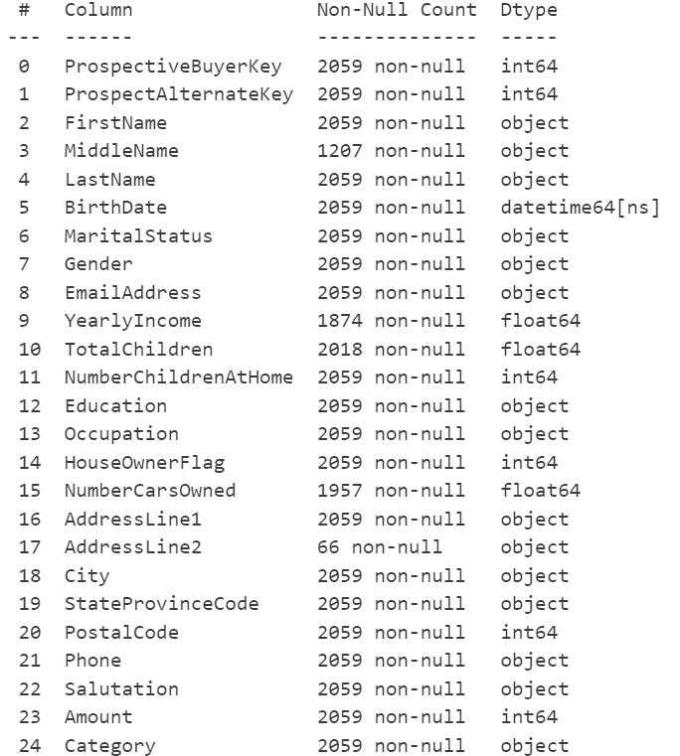
Importing packages
df = pd.read_excel('BikeBuyers2.xlsx')
df.head(5)
df.info()
#Show the statistics of each column

Slide 7
Load Packages and Data
Data Cleansing
Exploratory Data Analysis
Feature Selection
Machine Learning

Slide 8
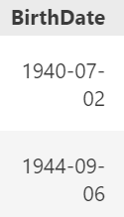
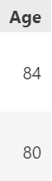
Data Cleansing BirthdDate——Age
#Processing missing value
df.drop(['FirstName', 'LastName'], axis=1, inplace=True)
df = df[df['TotalChildren'] >= df['NumberChildrenAtHome']]
df.dropna(subset=['YearlyIncome', 'TotalChildren', 'NumberCarsOwned'], inplace=True)
#Convert Time Format
df['BirthDate'] = pd.to_datetime(df['BirthDate'])
df['YearlyIncome'] = df['YearlyIncome'].astype(int)
df['Age'] = pd.to_datetime('today').year - pd.to_datetime(df['BirthDate']).dt.year
text_columns = df.select_dtypes(include=['object']).columns
df[text_columns] = df[text_columns].apply(lambda x: x.str.lower())
df.head()

Slide 9
Load Packages and Data
Data Cleansing
Exploratory Data Analysis
Feature Selection
Machine Learning

Slide 10
此处可以替换成学院标志
Income Distribution by Category
Category income
def categorize_income(income):
if 10000 <= income <= 30000:
return '10000-30000'
elif 30000 < income <= 60000:
return '30001-60000'
elif 60000 < income <= 90000:
return '60001-90000'
elif 90000 < income <= 120000:
return '90001-120000'
else:
return 'Out of Range'

Slide 11
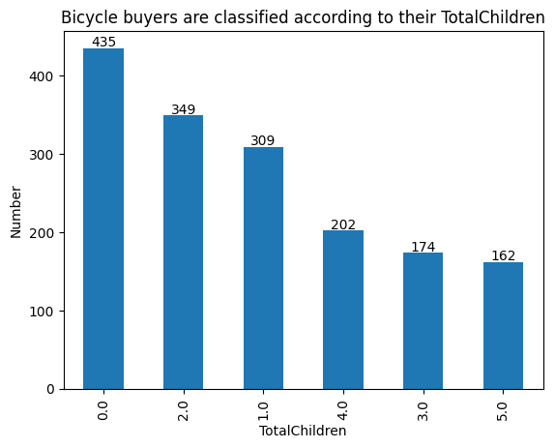
此处可以替换成学院标志
Classify according to their TotalChildren
child_counts = df['TotalChildren'].value_counts()
# 生成柱状图
ax=child_counts.plot(kind='bar')
plt.xlabel('TotalChildren')
plt.ylabel('Number')
plt.title('Bicycle buyers are classified according to their TotalChildren')
for i, v in enumerate(child_counts):
ax.text(i, v + 2, str(v), color='black', ha='center')
plt.show()

Slide 12
Load Packages and Data
Data Cleansing
Exploratory Data Analysis
Feature Selection
Machine Learning

Slide 13
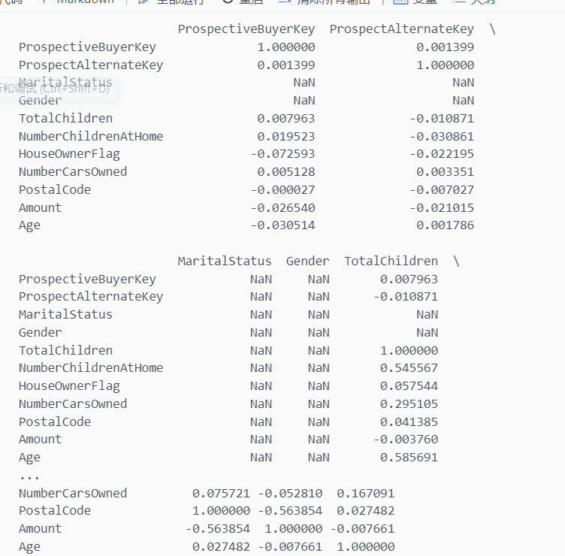
此处可以替换成学院标志
correlation analysis
numeric_data = df.select_dtypes(include=['int64', 'float64'])
spearman_corr = numeric_data.corr(method='spearman')
print(spearman_corr)
# Using seaborn to draw a heat map
sns.heatmap(spearman_corr, annot=True, cmap='coolwarm')
plt.show()

Slide 14
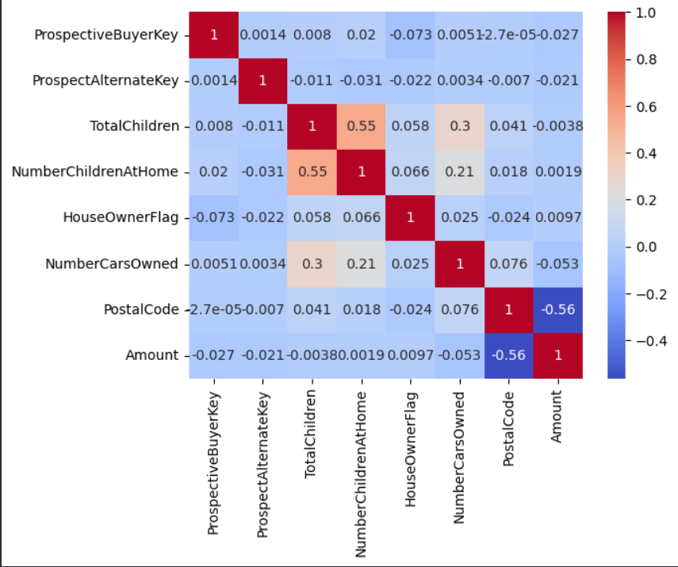
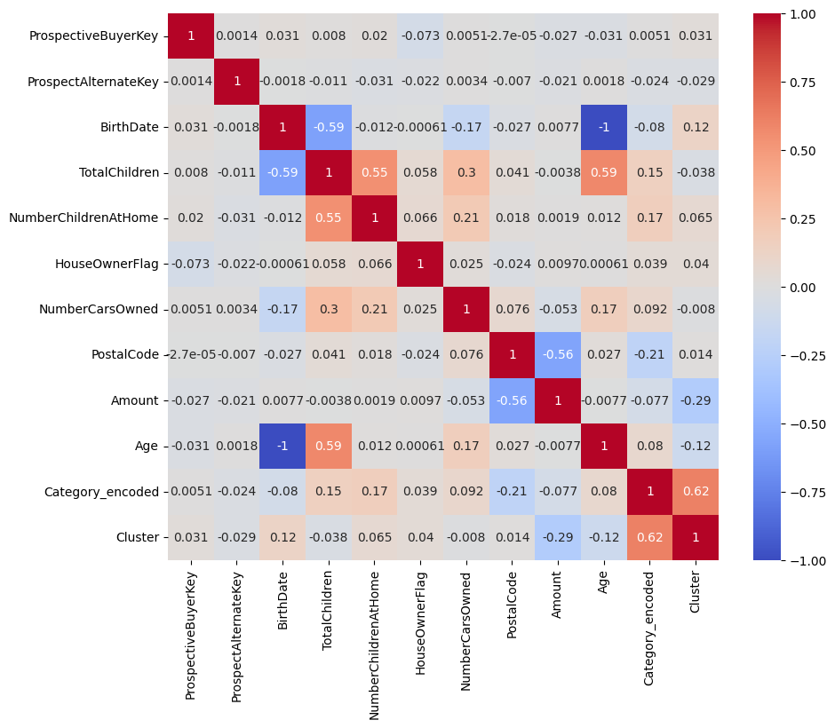
此处可以替换成学院标志
Feature Selection
与Category最相关的5个变量，按相关性强度排序：
PostalCode: -0.206579
NumberChildrenAtHome: 0.167753
TotalChildren: 0.154639
NumberCarsOwned: 0.091606
Amount: -0.076502
所以选择这5个变量作为后面的特征变量

Slide 15
Load Packages and Data
Data Cleansing
Exploratory Data Analysis
Feature Selection
Machine Learning

Slide 16
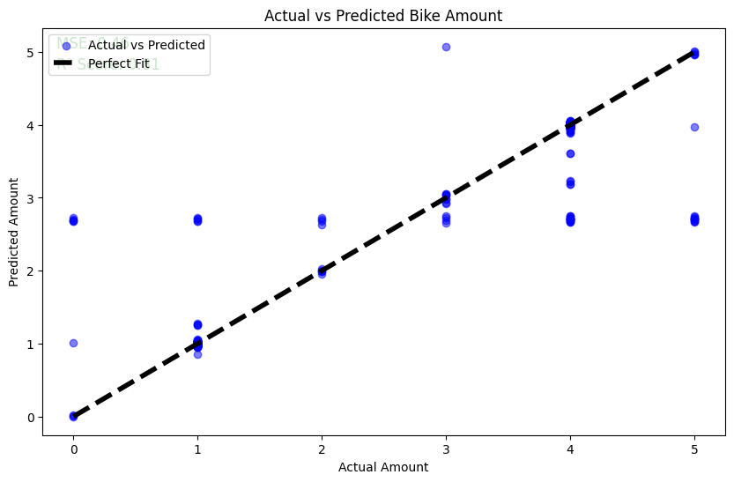
此处可以替换成学院标志
Linear regression
# 创建整个处理流程
model = Pipeline(steps=[('preprocessor', preprocessor),
('regressor', LinearRegression())])
# 划分训练集和测试集
X_train, X_test, y_train, y_test = train_test_split(X, y, test_size=0.2, random_state=42)
# 训练模型
model.fit(X_train, y_train)
# 预测
y_pred = model.predict(X_test)

Slide 17
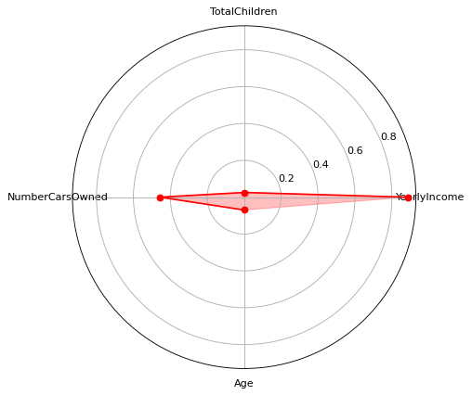
此处可以替换成学院标志
Radar chart
TotalChildren
YearlyIncome
0.03
0.9
NumberCarsOwned
Age
0.45
0.08

Slide 18
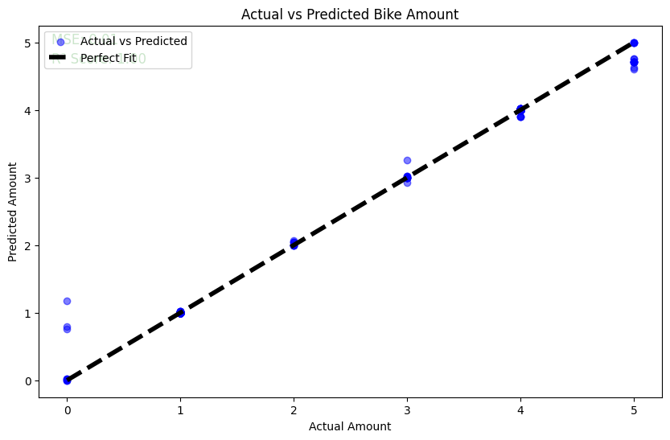
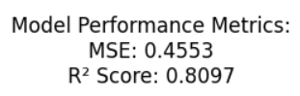
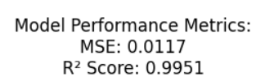
此处可以替换成学院标志
Improved
AFTER
BEFORE
# 处理Gender和MaritalStatus
gender_mapping = {'M': 0, 'F': 1}
df['Gender'] = df['Gender'].map(gender_mapping)
marital_status_mapping = {'M': 0, 'S': 1} # 根据实际数据调整映射
df['MaritalStatus'] = df['MaritalStatus'].map(marital_status_mapping)

Slide 19
此处可以替换成学院标志
Logistic regression
#模型训练
model = LogisticRegression(max_iter=1000)
model.fit(X_train, y_train)
#性能评估
y_pred = model.predict(X_test)
print("Accuracy:", accuracy_score(y_test, y_pred))
print("分类报告:\n", classification_report(y_test, y_pred))
Accuracy: 0.5504587155963303
分类报告:
precision recall f1-score support category 1 0.51 0.83 0.63 52 category 2 0.63 0.76 0.69 59 category 3 0.55 0.82 0.66 44 category 4 0.53 0.82 0.65 38 category 5 0.60 0.46 0.52 26 category 6 0.43 0.15 0.22 40 category 7 0.78 0.30 0.44 23 category 8 0.00 0.00 0.00 11 category 9 0.00 0.00 0.00 34 accuracy 0.55 327
macro avg 0.45 0.46 0.42 327
weighted avg 0.49 0.55 0.49 327

Slide 20

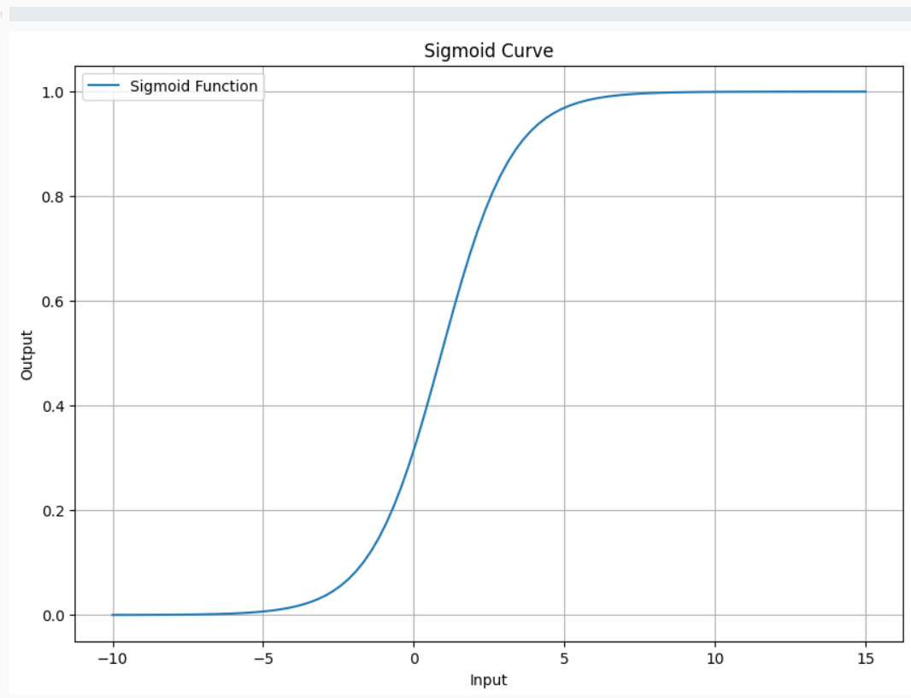
此处可以替换成学院标志
S
Sigmoid Curve
Y-axis: Input
X-axis: Output
def sigmoid(x):
return 1 / (1 + np.exp(-x))
# 选择一个特征（例如 'Amount'）并生成输入数据范围
amount_range = np.linspace(X['Amount'].min() - 10, X['Amount'].max() + 10, 100)
# 计算对应的 sigmoid 输出
y_sigmoid = sigmoid(coefficients[3] * amount_range + intercept)

Slide 21
此处可以替换成学院标志
Logistic regression
显示了模型预测每个类别的准确性，对角线表示正确预测的数量。
explain
预测为正类的样本中实际为正类的比例。
从上面的结果可以看出，模型在[具体类别]上的表现较好，需要调整模型参数或收集更多数据来改进性能。
S
W
- **混淆矩阵**
- **精度**
- **召回率**
T
O
- **F1得分**
实际为正类的样本中被预测为正类的比例。
精度和召回率的调和平均，用于平衡两者的重要性。

Slide 22

此处可以替换成学院标志
Knn
X = df[['YearlyIncome','TotalChildren','NumberChildrenAtHome','Amount']]
y = df['Category']
# X是特征数据，y是目标变量
X = df[['PostalCode','TotalChildren','NumberChildrenAtHome','Amount','NumberCarsOwned']]
y = df['Category'] X_train, X_test, y_train, y_test = train_test_split(X, y, test_size=0.2, random_state=42)
# 测试集的比例为20%，随机种子为42
k = 3 # 选择K值
knn = KNeighborsClassifier(n_neighbors=k)
# 使用自带的函数进行KNN分类，考虑最近的3个邻居
knn.fit(X_train, y_train) # 训练模型
y_pred = knn.predict(X_test)
Accuracy: 0.764525993883792
分类报告:
precision recall f1-score support
category 1 0.71 0.79 0.75 52 category 2 0.88 0.83 0.85 59 category 3 0.82 0.75 0.79 44 category 4 0.78 0.92 0.84 38 category 5 0.68 0.81 0.74 26 category 6 0.76 0.70 0.73 40 category 7 0.78 0.61 0.68 23 category 8 0.44 0.36 0.40 11 category 9 0.76 0.74 0.75 34 accuracy 0.76 327 macro avg 0.73 0.72 0.72 327
weighted avg 0.77 0.76 0.76 327

Slide 23
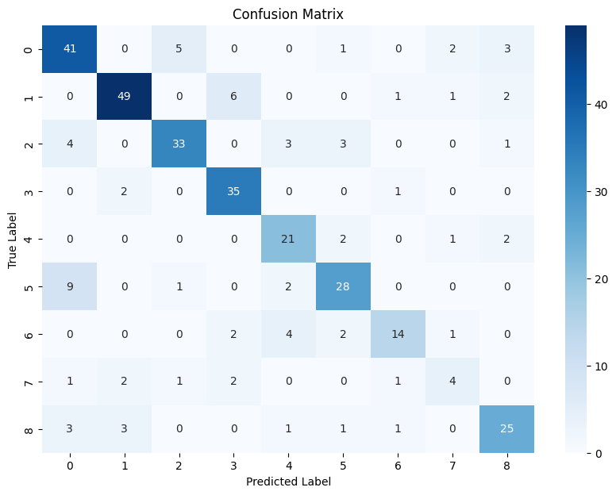
此处可以替换成学院标志
Confusion Matrix
Y-axis: True Label
X-axis: Predicted Label

Slide 24
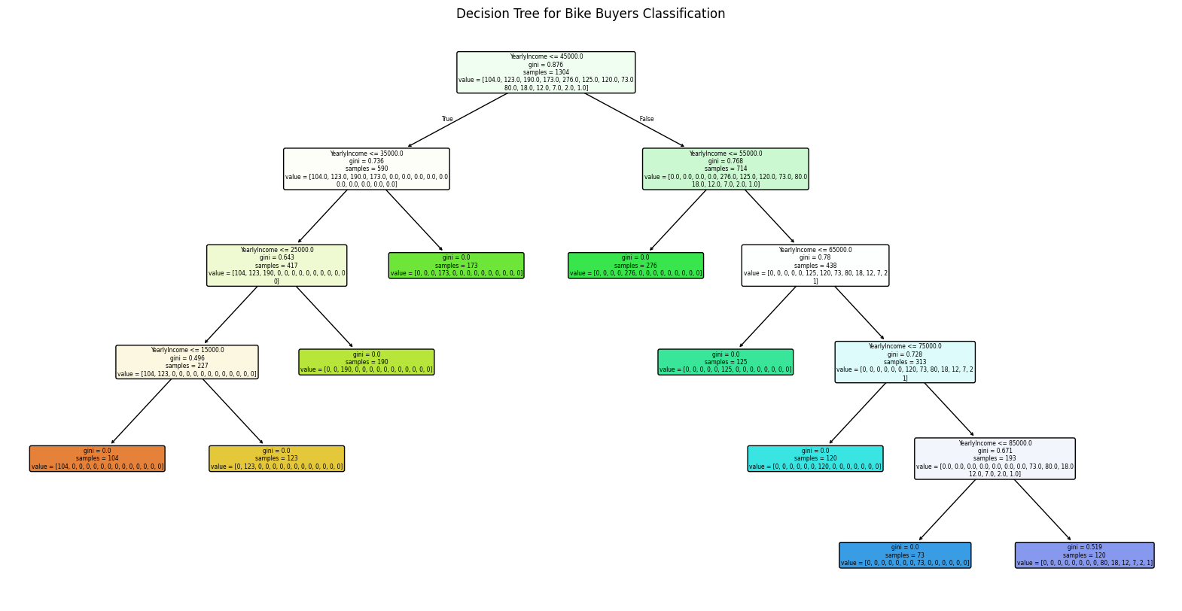
此处可以替换成学院标志
Tree-based model
# 创建分类器
model = DecisionTreeClassifier(max_leaf_nodes=9, random_state=42)
# 训练模型
model.fit(X_train, y_train)
# 使用 matplotlib 绘制决策树
plt.figure(figsize=(20, 10))
plot_tree(model, feature_names=X.columns, filled=True, rounded=True)
plt.title('Decision Tree for Bike Buyers Classification')# 添加标题
plt.show() # 显示图形

Slide 25
此处可以替换成学院标志
Gradient Boosting Trees
# 选择特征和目标变量
X = df[['PostalCode', 'TotalChildren', 'NumberChildrenAtHome', 'Amount', 'NumberCarsOwned']]
y = df['Category'] # 目标变量
# 使用 LabelEncoder 编码目标变量
le = LabelEncoder()
y_encoded = le.fit_transform(y)
# 分割数据集为训练集和测试集，确保分割后的数据集平衡
X_train, X_test, y_train, y_test = train_test_split(X, y_encoded, test_size=0.2, random_state=42, stratify=y_encoded)
# 创建和训练 Gradient Boosting 模型
gb_clf = OneVsRestClassifier(GradientBoostingClassifier(n_estimators=100, random_state=42))
gb_clf.fit(X_train, y_train)
# 模型预测
y_pred = gb_clf.predict(X_test)
# 计算 ROC 曲线和 AUC
y_prob = gb_clf.predict_proba(X_test)
fpr = {}
tpr = {}
roc_auc = {}
# 如果是多分类问题，计算每个类别的 ROC 曲线
for i in range(len(le.classes_)):
fpr[i], tpr[i], _ = roc_curve(y_test == i, y_prob[:, i])
roc_auc[i] = auc(fpr[i], tpr[i])
# 绘制 ROC 曲线
plt.figure(figsize=(10, 7))
for i in range(len(le.classes_)):
plt.plot(fpr[i], tpr[i], label=f'Class {le.classes_[i]} (AUC = {roc_auc[i]:.2f})')
在这里
输入文字
在这里
输入文字

Slide 26
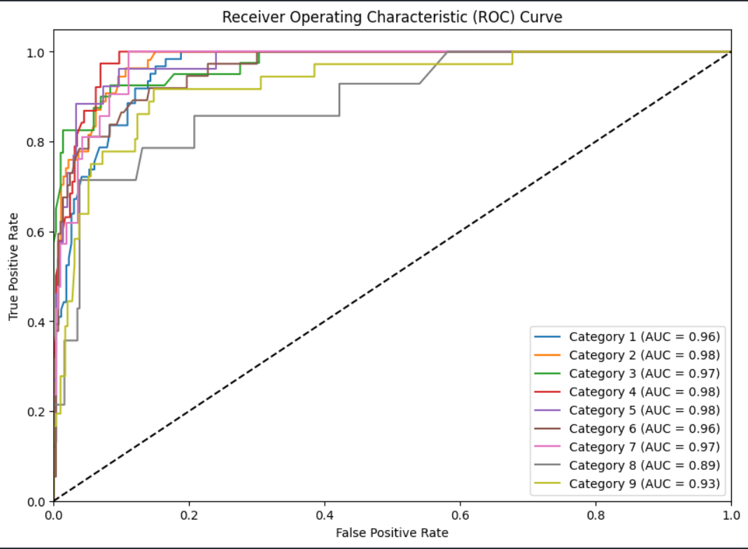
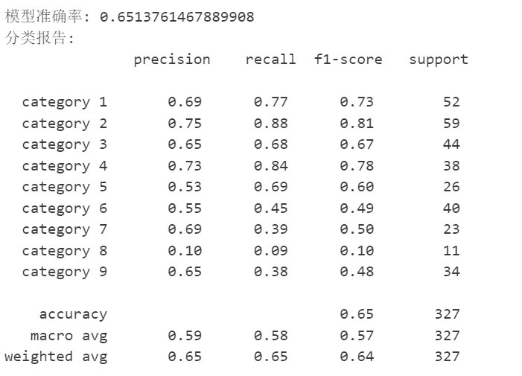
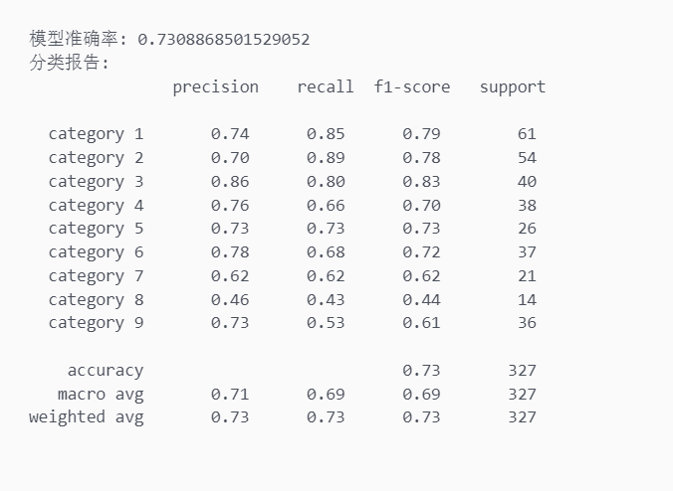
此处可以替换成学院标志
Gradient Boosting Trees
report
Receiver Operating Characteristic Curve

Slide 27
此处可以替换成学院标志
K-means
X = df[['Amount','Category_encoded']].values
# 使用k=3进行k-means聚类
kmeans_3 = KMeans(n_clusters=3, random_state=42)
labels_3 = kmeans_3.fit_predict(X)
# 使用k=9进行k-means聚类
kmeans_9 = KMeans(n_clusters=9, random_state=42)
labels_9 = kmeans_9.fit_predict(X)
# 计算轮廓系数
silhouette_avg_3 = silhouette_score(X, labels_3)
silhouette_avg_9 = silhouette_score(X, labels_9)
print(f"Silhouette Score for k=3: {silhouette_avg_3}")
print(f"Silhouette Score for k=9: {silhouette_avg_9}")
# 可视化结果
fig, ax = plt.subplots(1, 2, figsize=(12, 6))
# k=3的聚类结果
ax[0].scatter(X[:, 0], X[:, 1], c=labels_3)
ax[0].set_title('k=3 Clustering')
# k=9的聚类结果
ax[1].scatter(X[:, 0], X[:, 1], c=labels_9)
ax[1].set_title('k=9 Clustering')
plt.show()

Slide 28
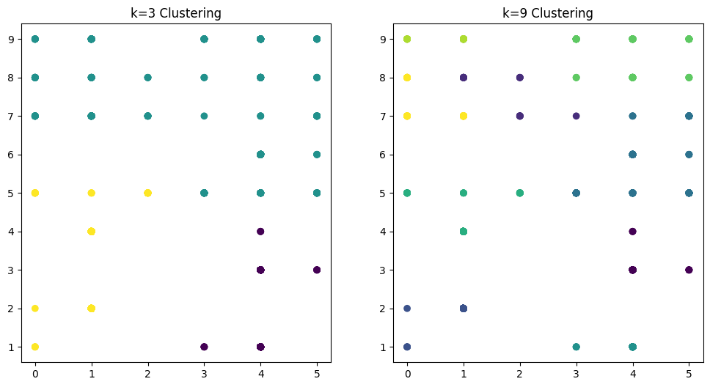
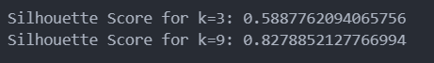
此处可以替换成学院标志
K-means
左图（k=3）：
当k=3时，K-means算法将数据分为三个簇。我们可以看到图中显示了三个不同颜色的簇，每个簇由K-means算法识别并标记。。 右图（k=9）：
当k=9时，K-means算法将数据分为九个簇。相比k=3时，聚类的细分更多，每个簇更小。
分析比较：
k=3的情况下，聚类的结果显示出相对大的簇，每个簇的形状比较集中。 k=9的情况下，数据被更细化地划分为多个小簇，每个簇的中心更接近其内部数据点的平均位置。
- 横坐标为Amount，纵坐标为Category
- K=3 表示分为3簇；K=9表示分为9簇
- 离得近的为一簇
- 轮廓系数越大聚类效果越好

Slide 29
此处可以替换成学院标志
Cross validation——code
X = df[['PostalCode','TotalChildren','NumberChildrenAtHome','Amount','NumberCarsOwned']]
y = df['Category'] logistic_reg = LogisticRegression(max_iter=1000)
knn = KNeighborsClassifier(n_neighbors=3) # 交叉验证比较模型性能
logistic_scores = cross_val_score(logistic_reg, X, y, cv=4, scoring='accuracy')
knn_scores = cross_val_score(knn, X, y, cv=4, scoring='accuracy') # 输出每个模型的交叉验证准确率
print("Logistic Regression Accuracy:", logistic_scores.mean())
print("knn Accuracy:", knn_scores.mean()) #进行k不同交叉验证
knn_scores_cv4 = cross_val_score(knn, X, y, cv=4, scoring='accuracy')
knn_scores_cv10 = cross_val_score(knn, X, y, cv=10, scoring='accuracy')
# 输出k为不同值的交叉验证准确率
print("knn with cv=4 Accuracy:", knn_scores_cv4.mean())
print("knn with cv=10 Accuracy:", knn_scores_cv10.mean())
#绘制肘部曲线以找到最好的k值
elbow = []
for i in range(1, 20): # 创建遍历，找到最合适的k值
kmeans = KMeans(n_clusters=i, init='k-means++', random_state=100)
kmeans.fit(X)
elbow.append(kmeans.inertia_)
plt.figure(figsize=(9, 6))
plt.plot(range(1, 20), elbow, marker='o', linestyle='--')
plt.xlabel('Number of Clusters (K)')
plt.ylabel('Inertia')
plt.title('Elbow Method for Optimal K')
plt.xticks(np.arange(1, 20, 1))
plt.grid(True)
plt.show()

Slide 30
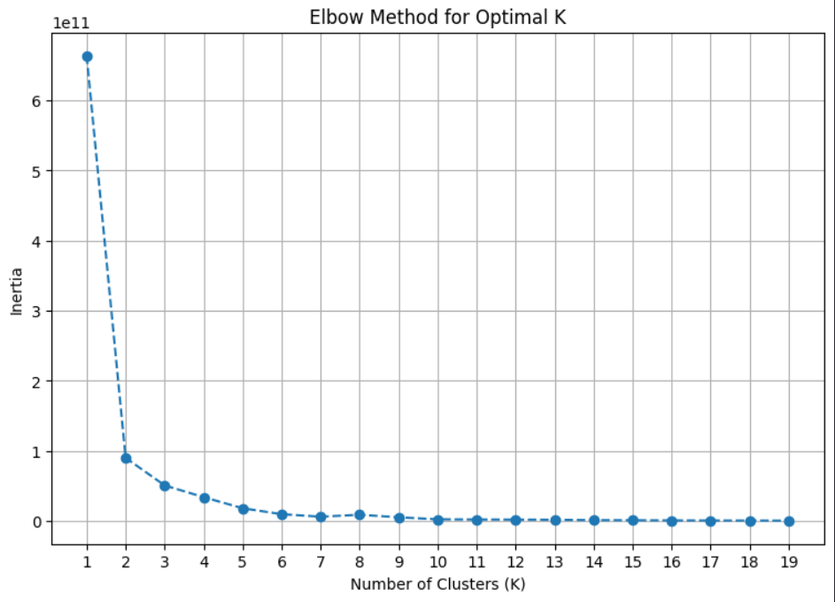
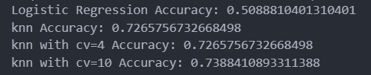
此处可以替换成学院标志
Cross validation——RESULT

Slide 31
此处可以替换成学院标志
DBSCAN——code
# 提取每个簇的数据
unique_labels = set(labels)
colors = plt.cm.get_cmap('tab10', len(unique_labels))
for i, label in enumerate(unique_labels):
if label == -1:
# 如果是噪声点，以黑色单独标记
plt.scatter(X[labels == label, 0], X[labels == label, 1], color='black', s=30, label='Noise')
else:
plt.scatter(X[labels == label, 0], X[labels == label, 1], color=colors(i), s=30, label=f'Cluster {label}')
plt.title('DBSCAN Clustering')
plt.xlabel('Amount')
plt.ylabel('Category')
plt.legend()
plt.grid(True)
plt.show()
X = df[['Amount','Category_encoded']].values # 提取需要处理的特征作为numpy数组
# 如果数据不是同一量级，可以进行标准化处理
scaler = StandardScaler()
X_scaled = scaler.fit_transform(X)
eps = 0.3 # 邻域半径
min_samples = 10 # 最小样本数
dbscan = DBSCAN(eps=eps, min_samples=min_samples)
labels = dbscan.fit_predict(X_scaled)
# 将结果添加到数据框中
df['Cluster'] = labels
plt.figure(figsize=(10, 6))

Slide 32
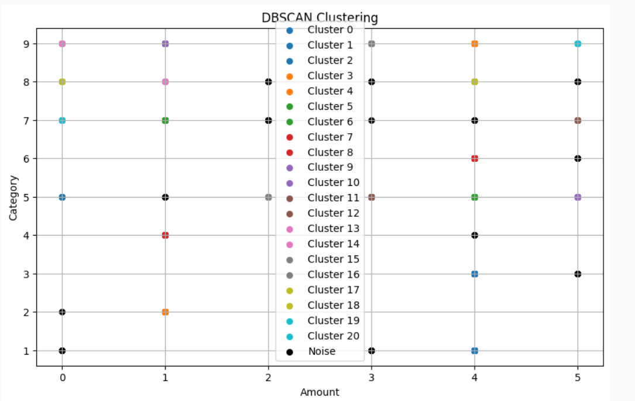
此处可以替换成学院标志
DBSCAN——RESULT

Slide 33
此处可以替换成学院标志
Random Forest——code
label_encoder = LabelEncoder()
df['Category'] = label_encoder.fit_transform(df['Category'])
# 分离特征和目标变量
X = df[['PostalCode','TotalChildren','NumberChildrenAtHome','Amount','NumberCarsOwned']]
y = df['Category']
# 将目标变量二值化
y_bin = label_binarize(y, classes=range(len(df['Category'].unique())))
# 分割数据集为训练集和测试集
X_train, X_test, y_train, y_test = train_test_split(X, y_bin, test_size=0.2, random_state=42)
# 创建和训练一对多的随机森林模型
ovr_rf_model = OneVsRestClassifier(RandomForestClassifier(n_estimators=100, random_state=42))
ovr_rf_model.fit(X_train, y_train)
# 绘制每个类别的精确率-召回率曲线
plt.figure(figsize=(10, 7))
for i in range(y_bin.shape[1]):
PrecisionRecallDisplay.from_estimator(ovr_rf_model.estimators_[i], X_test, y_test[:, i], name=f"Class {i+1}")
plt.title('Precision-Recall Curve for Multiclass')
plt.show()

Slide 34
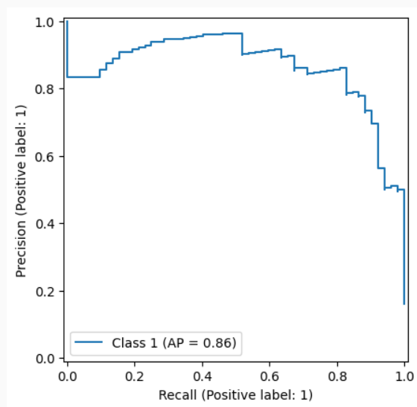
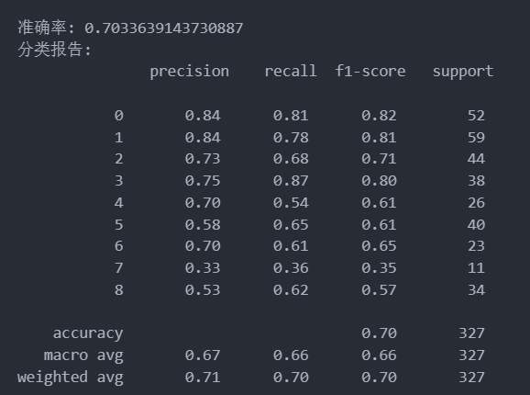
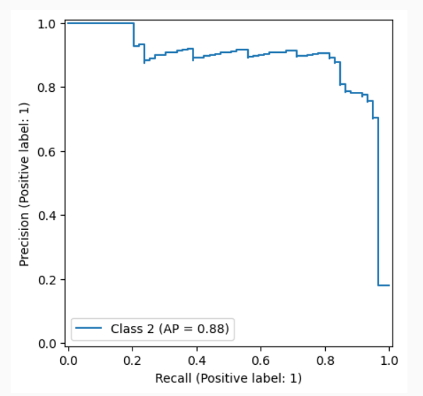
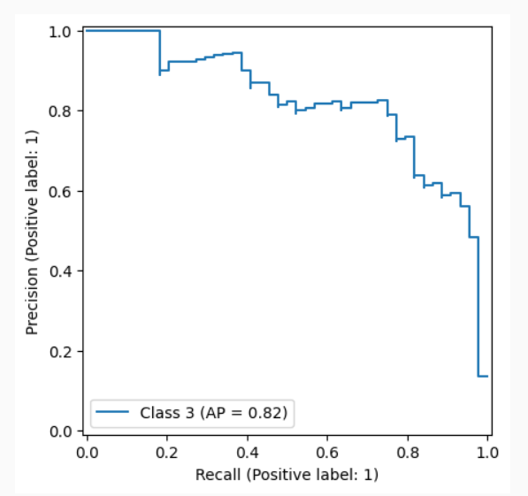
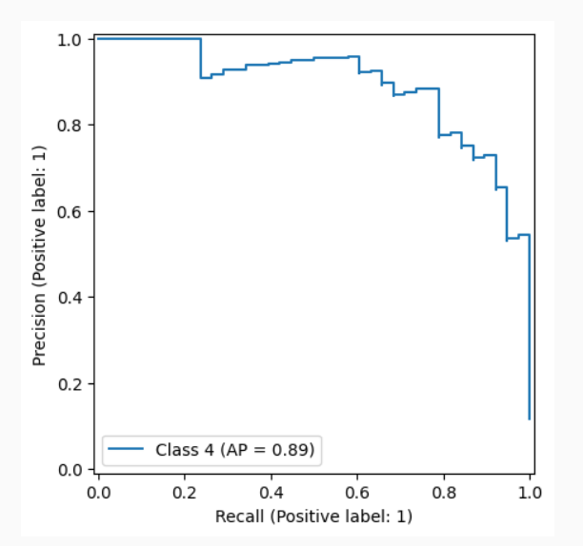
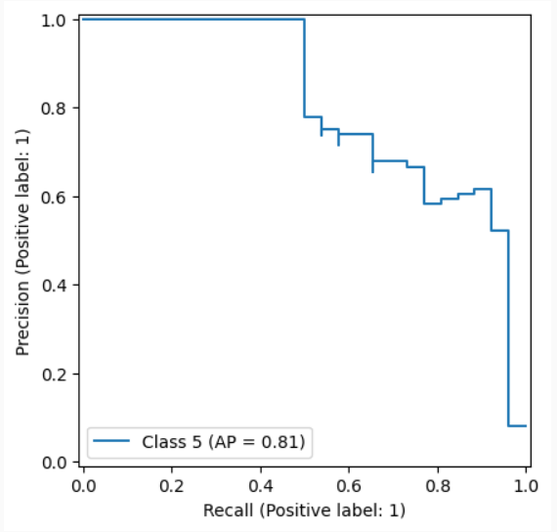
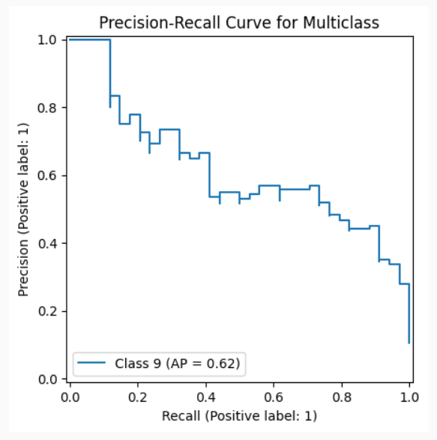
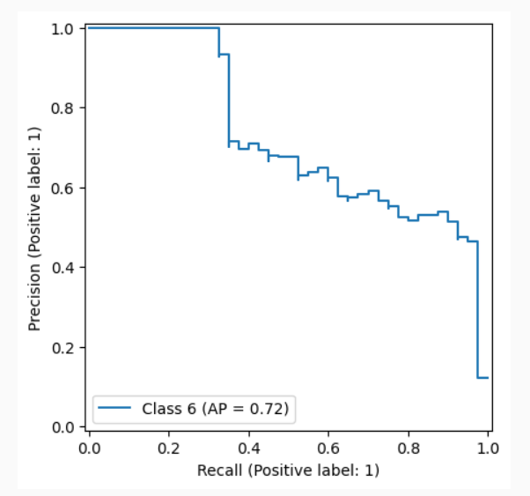
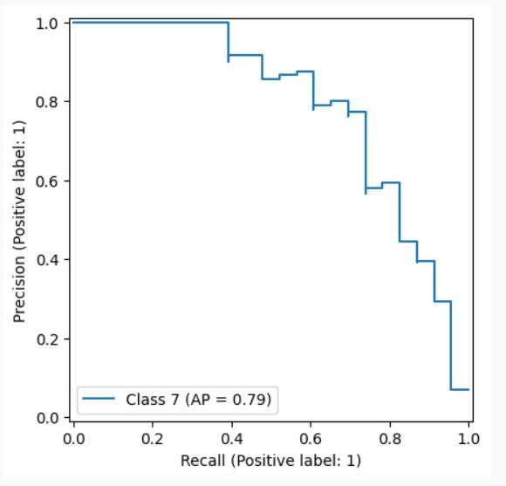
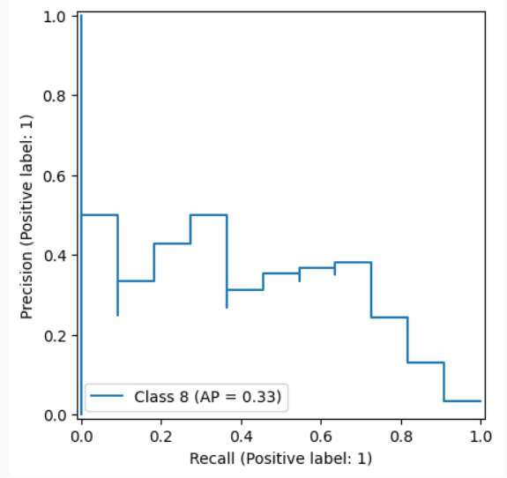
此处可以替换成学院标志
Random Forest——RESULT

Slide 35
此处可以替换成学院标志
AdaBoost——code
X = df[['PostalCode', 'TotalChildren', 'NumberChildrenAtHome', 'Amount', 'NumberCarsOwned']]
y = df['Category']
# 分割数据集为训练集和测试集
X_train, X_test, y_train, y_test = train_test_split(X, y, test_size=0.2, random_state=42)
# 初始化 AdaBoost 分类器
ada = AdaBoostClassifier(n_estimators=100, algorithm='SAMME', random_state=42)
# 拟合模型
ada.fit(X_train, y_train)
# 预测测试集
y_pred = ada.predict(X_test)
# 评估模型
accuracy = accuracy_score(y_test, y_pred)
# 计算并绘制每个类别的ROC曲线
n_classes = len(np.unique(y_test))
if n_classes == 1:
print("Warning: Only one class in the test set. ROC curve will not be meaningful.")
else:
plt.figure(figsize=(10, 7))
colors = ['b', 'g', 'r', 'c', 'm', 'y', 'k']
plt.legend(loc="lower right")
plt.plot([0, 1], [0, 1], 'k--')
# 绘制对角线（随机猜测线）
plt.xlim([0.0, 1.0])
plt.ylim([0.0, 1.05])
plt.xlabel('False Positive Rate')
plt.ylabel('True Positive Rate')
plt.title('ROC Curve for All Classes')
plt.show()

Slide 36
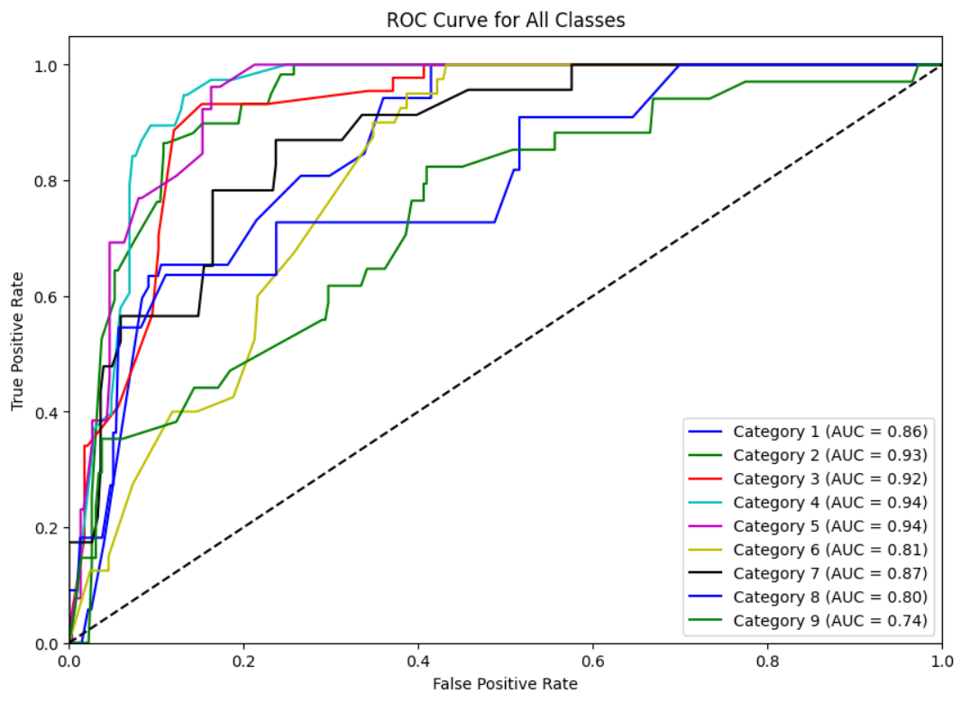
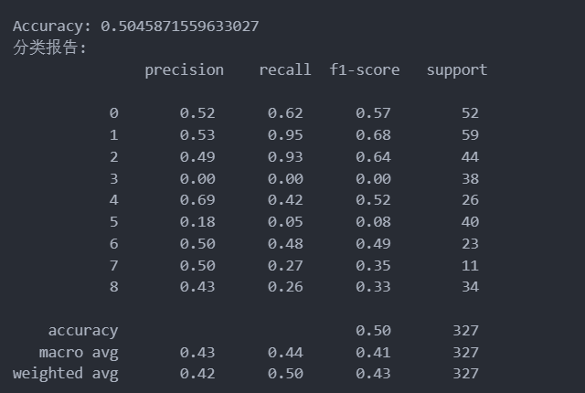
此处可以替换成学院标志
AdaBoost——RESULT

Slide 37
此处可以替换成学院标志
PCA——code
# 选择用于PCA的数据列，通常是数值型数据列
selected_columns = ['PostalCode','TotalChildren','NumberChildrenAtHome','Amount','NumberCarsOwned']
data_for_pca = cleaned_data[selected_columns] # 标准化数据
scaler = StandardScaler()
scaled_data = scaler.fit_transform(data_for_pca)
# 创建PCA对象
pca = PCA() # 在标准化后的数据上拟合PCA模型
pca.fit(scaled_data) # 查看主成分的方差解释比例
print(pca.explained_variance_ratio_) # 可选择性地，将数据转换到PCA的主成分空间
pca_data = pca.transform(scaled_data)
# 将PCA转换后的数据转为DataFrame
pca_df = pd.DataFrame(data=pca_data, columns=['PostalCode','TotalChildren','NumberChildrenAtHome','Amount','NumberCarsOwned'])
# 根据实际主成分数目命名列名 # 将PCA转换后的数据与原始数据合并
final_data = pd.concat([cleaned_data.reset_index(drop=True), pca_df], axis=1) # 可选择性的输出结果或进一步处理
print(final_data.head())

Slide 38
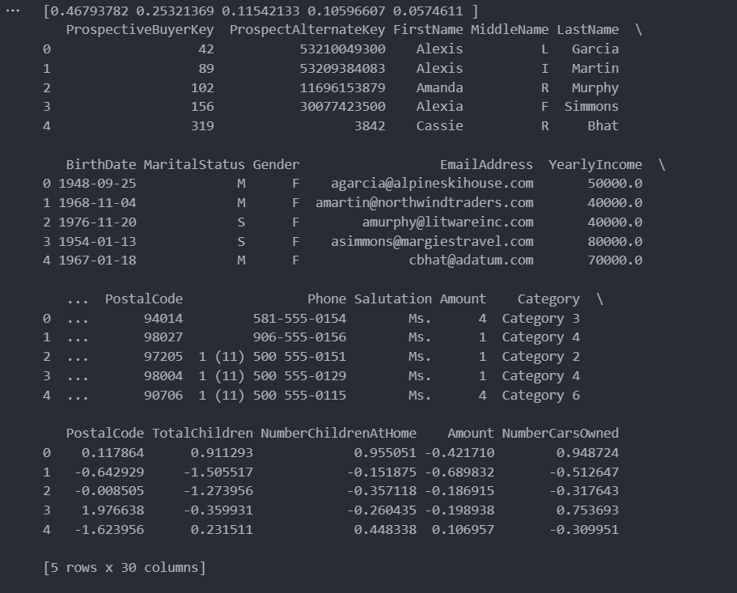
此处可以替换成学院标志
PCA——Chart

Slide 39
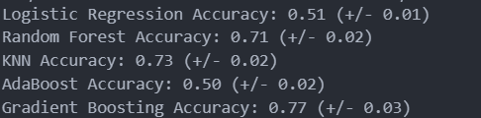
此处可以替换成学院标志
Summary
models = {
"Logistic Regression": log_reg,
"Random Forest": ovr_rf_model,
"KNN": knn,
"AdaBoost": ada,
"Gradient Boosting": gb_clf
}
# 评估模型
for name, model in models.items():
scores = cross_val_score(model, X, y, cv=5, scoring='accuracy')
print(f"{name} Accuracy: {np.mean(scores):.2f} (+/- {np.std(scores):.2f})")

Slide 40
02
Zombie Enterprise
- 艰苦创业 开拓创新 争创一流 -

Slide 41
Data Management
Machine Learning
厚德健行

Slide 42
Data Management
Load the data
Read the 4 tables
Merge the 4 tables into 1
Show the results

Slide 43
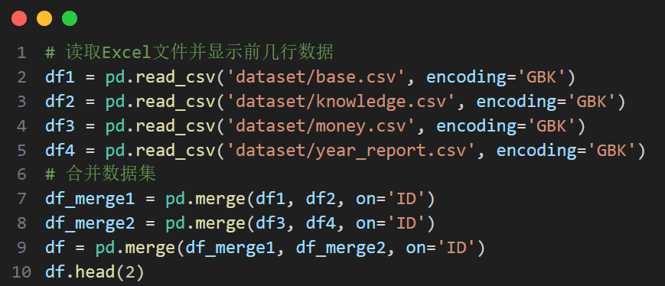
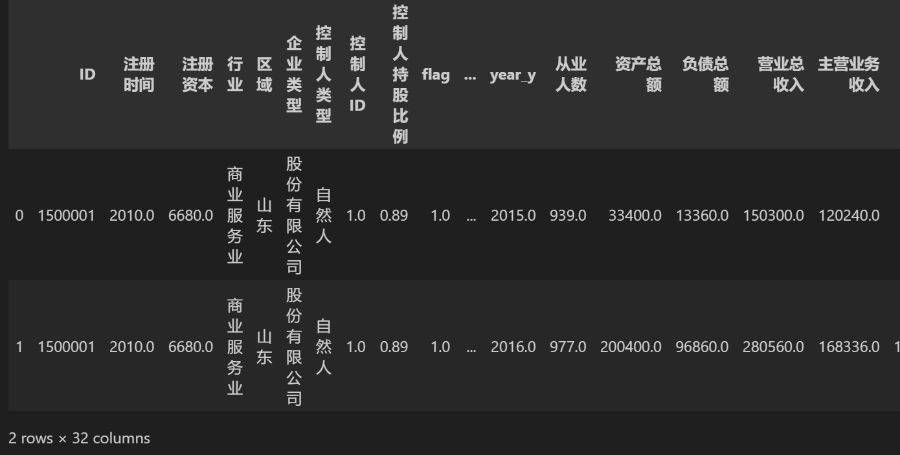
Data Management
Load the data

Slide 44
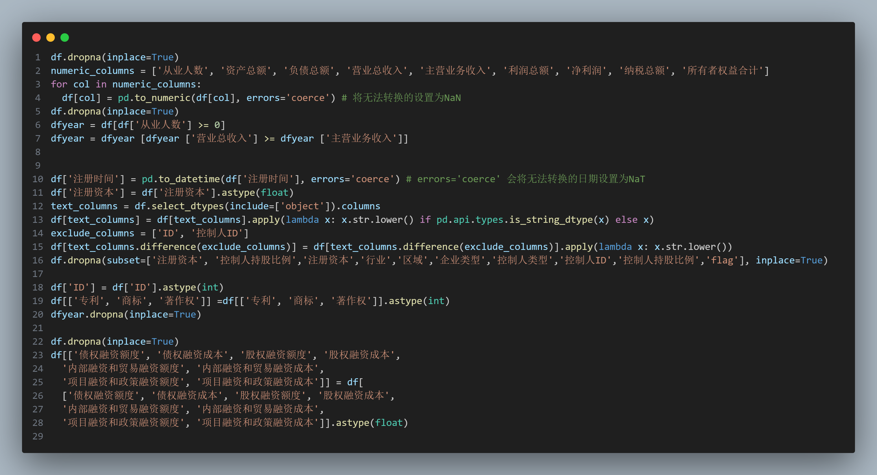
Data Management
Data Cleansing
Remove missing values
Numeric type conversion
Filter data
Date type conversion
Floating point type conversion
Text data processing
By 杨潇林

Slide 45
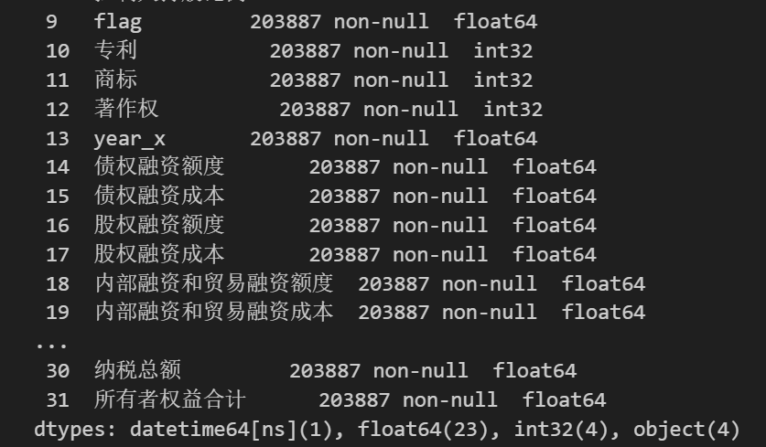
Data Management
By 杨潇林

Slide 46
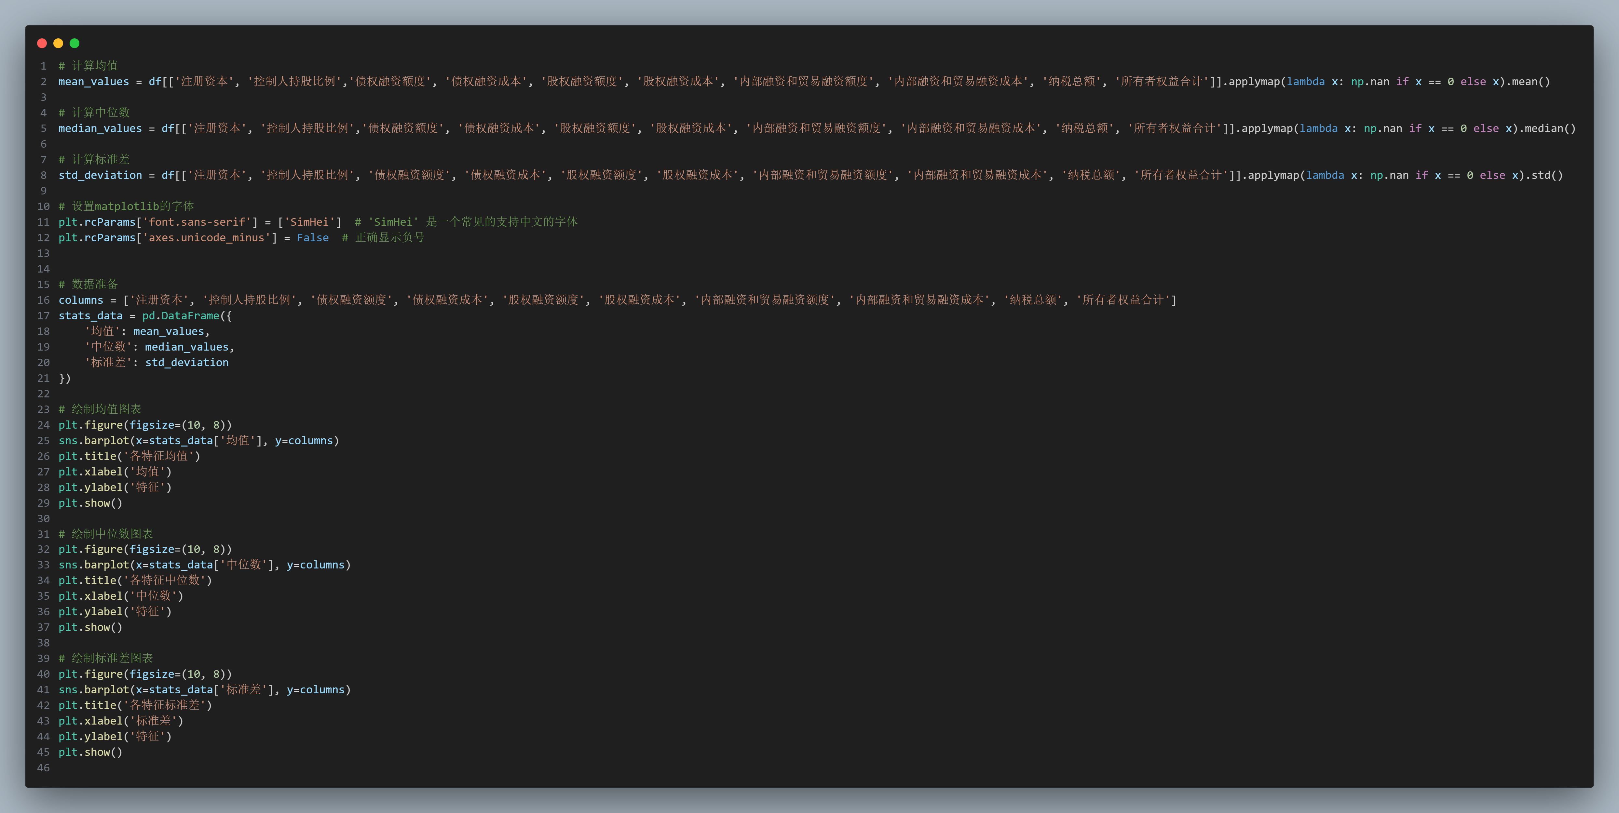
Data Management
Exploratory Data Analysis
By 马晨烨、杨潇林、秦睿思

Slide 47
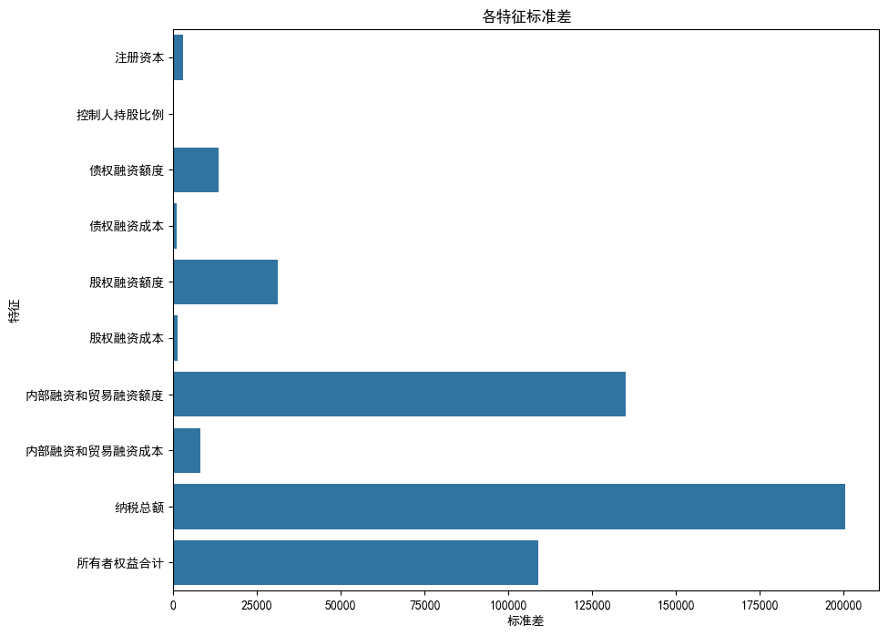
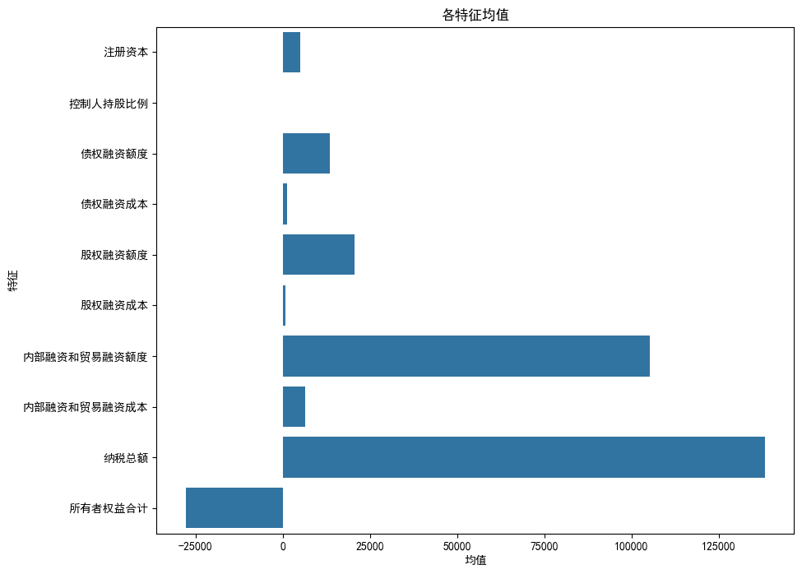
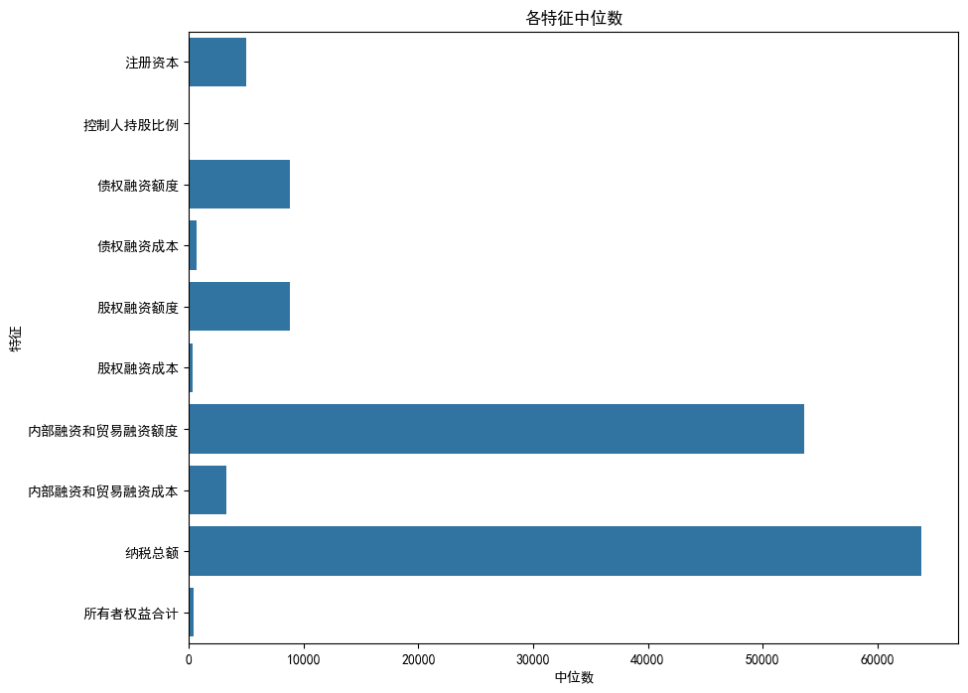
Data Management
Exploratory Data Analysis
By 马晨烨、杨潇林、秦睿思

Slide 48
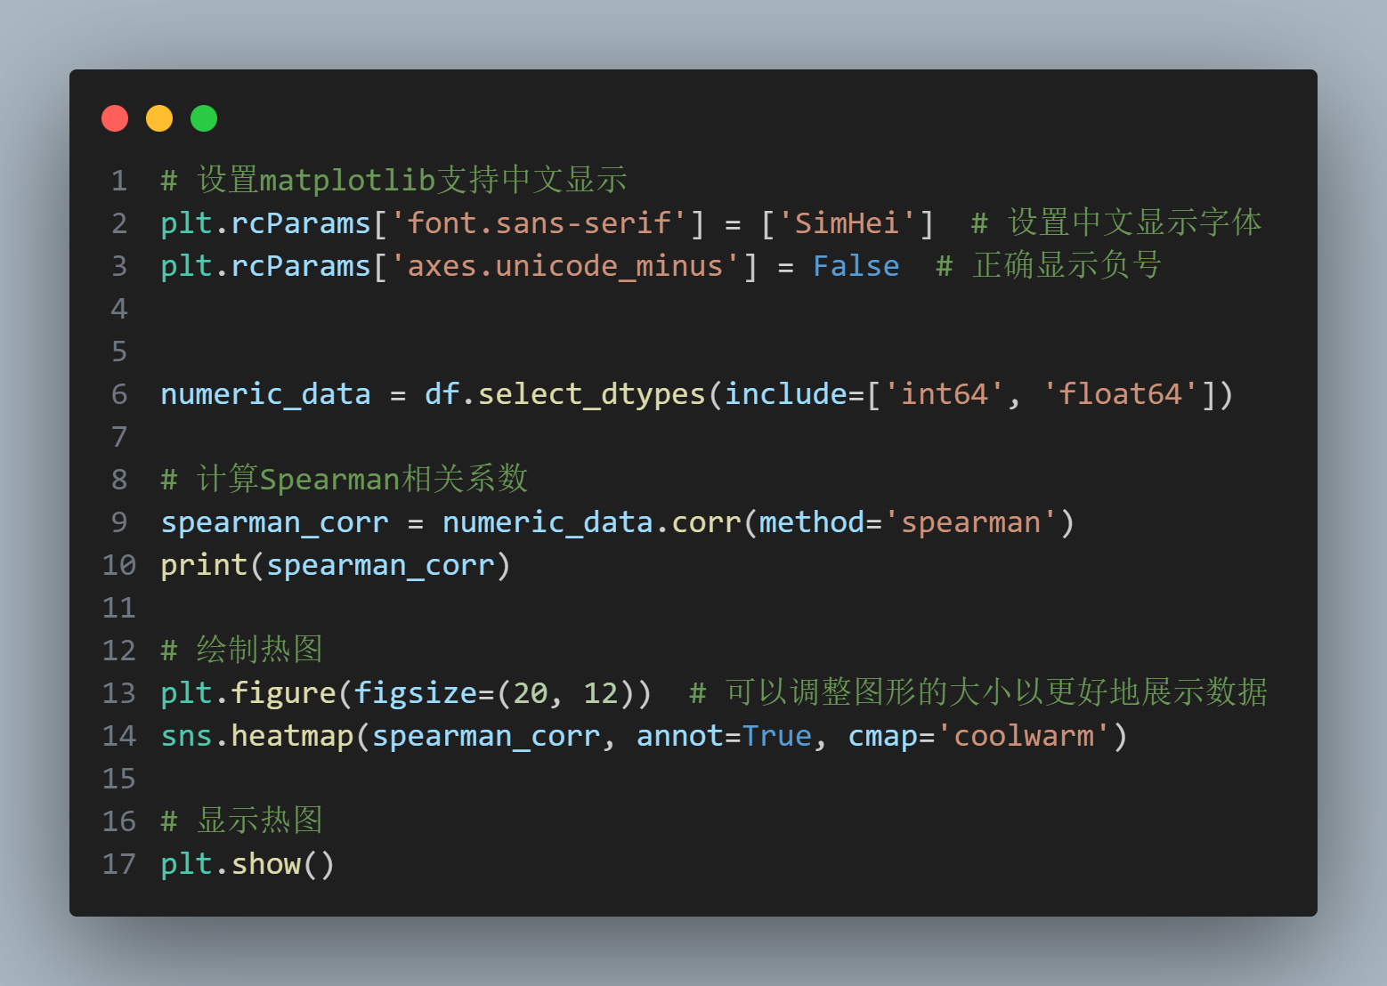
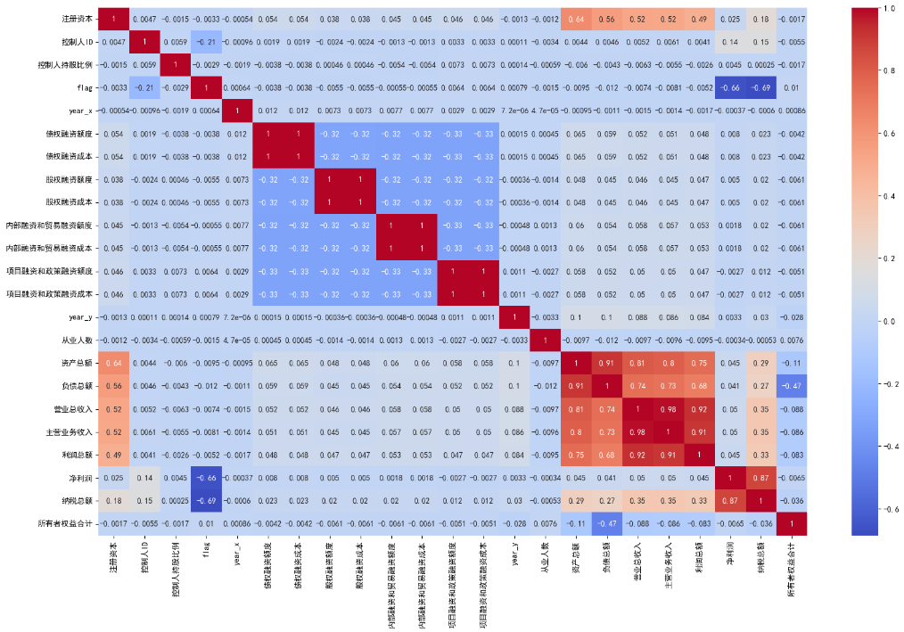
Data Management
Correlation Analysis and Feature Selection
纳税总额
净利润
资产总额
营业总收入
项目融资和政策融资成本
项目融资和政策融资额度
By 马晨烨、杨潇林、秦睿思

Slide 49
Data Management
Machine Learning
厚德健行

Slide 50
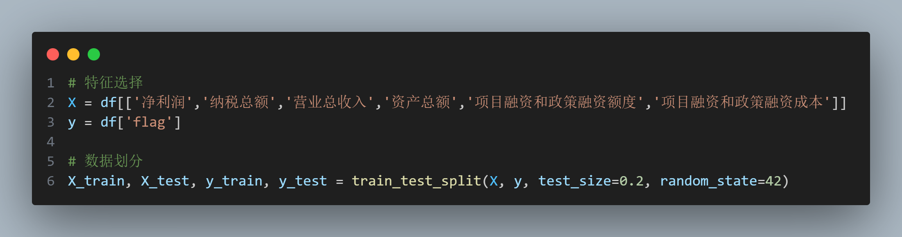
Machine Learning
Feature selection and Data partitioning

Slide 51
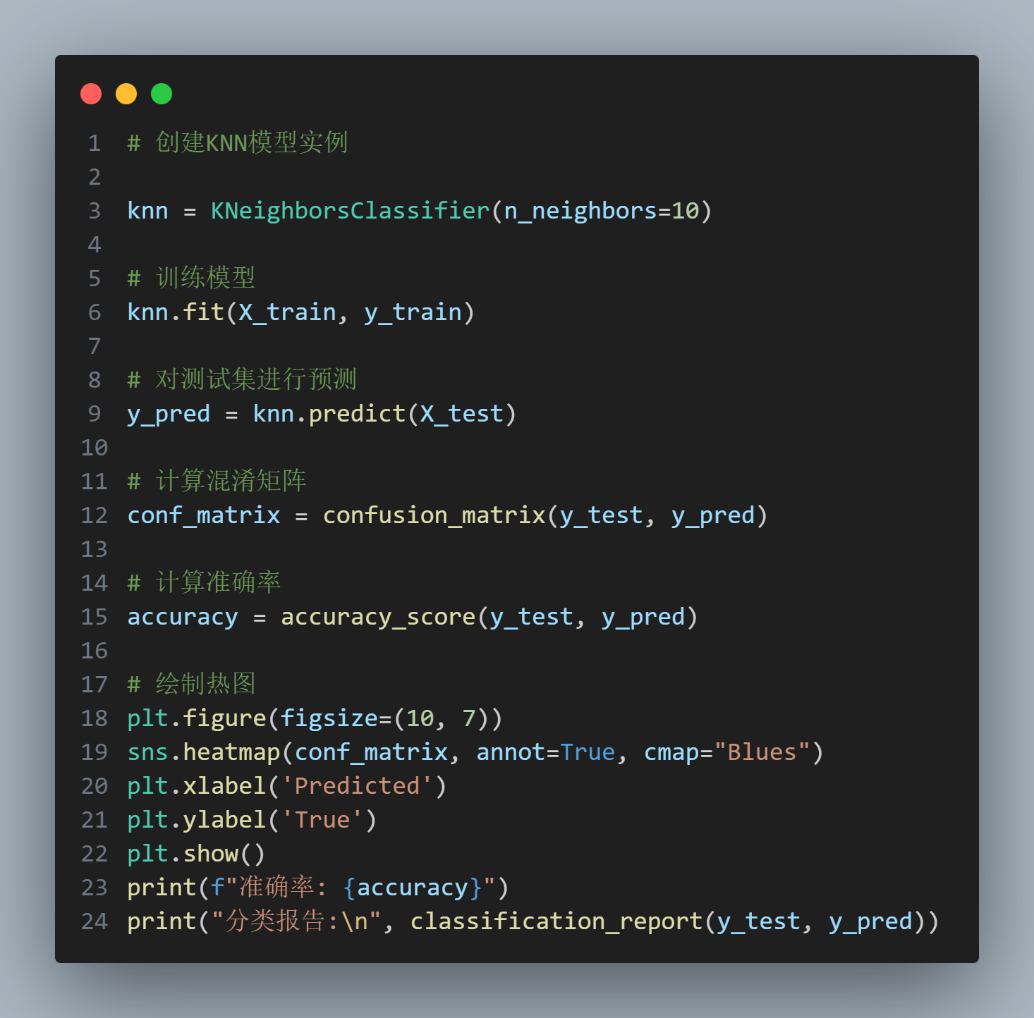
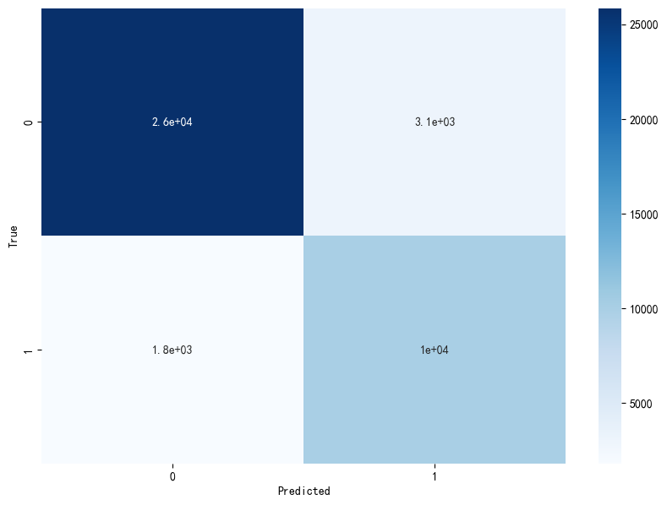

Machine Learning
KNN
By 马晨烨、杨潇林、秦睿思

Slide 52








Machine Learning
Logistic
Regression
By 马晨烨、阮扬程

Slide 53



Machine Learning
LDA
By 吴菲涵、马晨烨、杨潇林

Slide 54




Machine Learning
Random Forest
By 马晨烨、杨潇林

Slide 55




Machine Learning
AdaBoost
By 马晨烨、杨潇林、吴菲涵

Slide 56


Machine Learning
Cross validation
By 马晨烨、阮扬程

Slide 57
此处可以替换成学院标志
division of labor
Product owner ：马晨烨
Product manager ：秦睿思
Business translator ：吴菲涵
Data scientist ：阮扬程
Data engineer ：杨潇林
Bikebuyers ：
Data cleaning ：杨潇林
Exploratory data analysis ：吴菲涵、阮扬程、秦睿思
Linear regression ：吴菲涵、马晨烨、杨潇林
Logistic regression ：马晨烨、阮扬程
KNN ：马晨烨、秦睿思、杨潇林
Cross validation and elbow：阮扬程
K-means ：秦睿思、马晨烨
DBSCAN ：秦睿思
Decision tree ：吴菲涵
Random Forest ：马晨烨、阮扬程、吴菲涵
AdaBoost ：吴菲涵、杨潇林
PCA ：秦睿思
Zombie Enterprise：
Data cleaning ：杨潇林
Exploratory data analysis ：马晨烨、杨潇林、秦睿思
LDA ：吴菲涵、马晨烨、杨潇林
Logistic regression ：马晨烨、阮扬程、秦睿思
KNN ：马晨烨、秦睿思、杨潇林
Cross validation and elbow：阮扬程
AdaBoost ：吴菲涵、杨潇林

Slide 58
Thanks for listening
CONTENT PAGE
- 艰苦创业 开拓创新 争创一流 -

